Slide 1
VMS Version 3
MS4 & AMI
www.infratec-uk.com

Slide 2
House Keeping
We will be going into the workshop so, please...
Wear appropriate footwear
Stay with group
Signs are on wheels so be careful when working or leaning on signs
You are required to always display your name badge within the building.
No fire alarms planned for today.
Follow myself in the event of an alarm.
Toilets are in reception or across in Unit 8.
www.infratec-uk.com

Slide 3

Introduction
Who we are & what we do
www.infratec-uk.com

Slide 4
Introduction
VMS Limited
V2
Techspan
V2
HILL & SMITH
VMSL V3
www.infratec-uk.com

Slide 5

Agenda
Equipment overview
Detailed Technical Description
MS4
AMI
Roadside Controller intro
NRTS Interface (SFP/cat5)
RSC Navigation
Software upload
Download logs
RMAS Interface
Fault Finding
Logfile viewer
logfiles
Hands on
Q & A practical
www.infratec-uk.com

Slide 6
Introduction
MS4
AMI
AMI
AMI
CMU
RSC
www.infratec-uk.com

Slide 7
VMS Version 3
MS4
www.infratec-uk.com

Slide 8
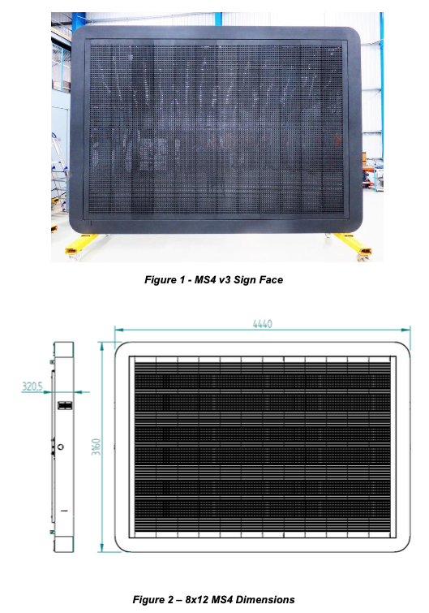
MS4 Overview
Dimensions | 4440mm x 3160mm x 320mm
Weight | 700kg
Power consumtion | 350W quiesent, 1100W at Level 6
PSUs | 4 x TDK hot swap blades
Character Modules | 96 x RGB V3
Parameter | Value
Display Type | Matrix RGB LEDs
Input Voltage Range | 230-265VAC, 47 - 63Hz
Lantern Type | Virtual on the main display face
Optical Performance | BSEN 12966:2014 C2, L3, R3, B3
Environmental Performance | BSEN 12966:2014 T1, P3, SP2
Reaction to horizontal load | WL8; PL0, DSL0; TDB1
www.infratec-uk.com

Slide 9
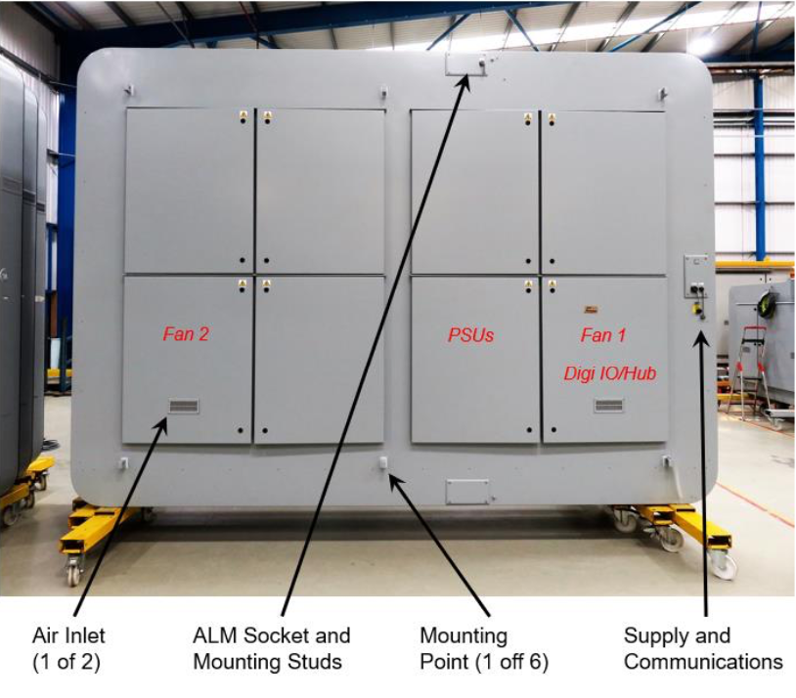
MS4 Access Doors
www.infratec-uk.com

Slide 10
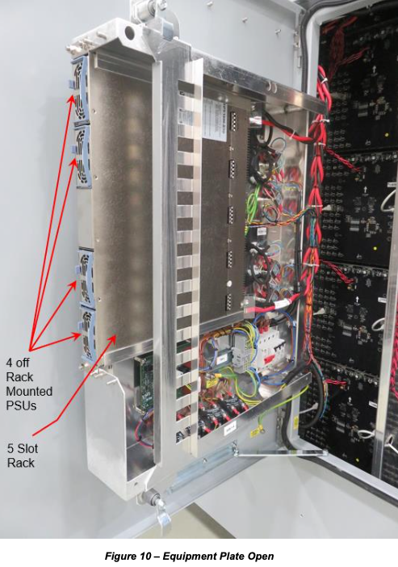
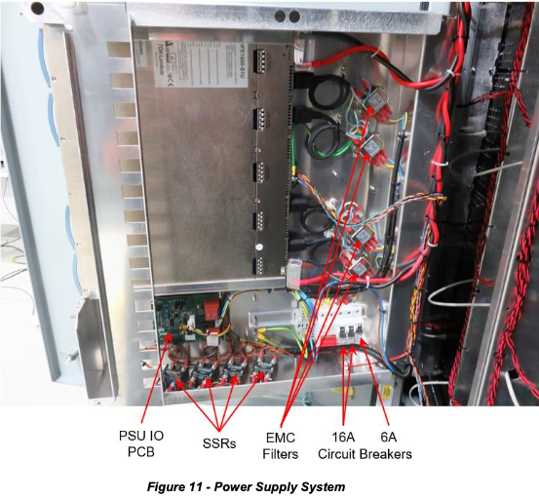
MS4 PSU Rack
www.infratec-uk.com

Slide 11
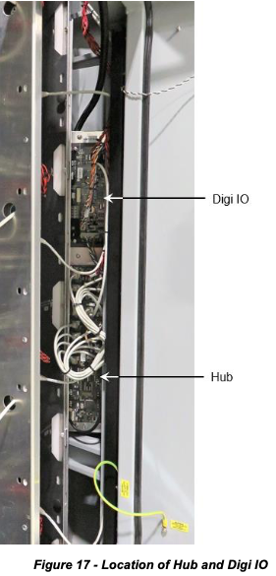
Header
Digi IO
A single Digi IO module is installed within the sign. In the MS4 the Digi IO performs the following functions:
Controls the fans within the sign enclosure.
Drives the external status LEDs.
Monitors the PSU rack.
HUB
There is a single Hub Module within the sign face. The Hub interfaces between the Gantry Controller and all the PCBs in the sign. Upon power up (or upon command) the Hub dynamically addresses all Character Modules in the sign. Messages received from the Gantry Controller are echoed out to the other modules as required, with the replies routed back to the Gantry Controller.
www.infratec-uk.com

Slide 12
MS4 Power Distribution
www.infratec-uk.com

Slide 13
MS4 Module Power
www.infratec-uk.com

Slide 14
MS4 Module Comms
www.infratec-uk.com

Slide 15
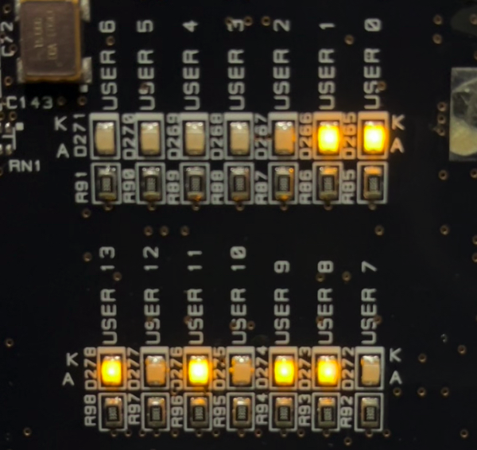
Character Module User LEDS
LED | Purpose | Indication
USER0&1 | Lantern sync | Flashes at 400 msec with the Lantern Sync signal. This signal is synchronised by messages received from the Gantry Controller via the Hub
USER8 | Tx indicator (USARTS 1 to 3) | Transmit Indicator Flashes on replies to messages received from the Gantry Controller, on either the primary or secondary comms channel, via the Hub
USER9 | Rx indicator (USARTS 1 to 3) | Receive Indicator
 |  | Flashes on receipt of messages received from the Gantry Controller, on either the primary or secondary comms channel, via the MS4 Controller / Hub.
USER11 | Heartbeat | Flashes when the software is running.
USER13 | Timer Tick/ Address Configured | Flashes with the 1 msec timer tick signal (appears to be continuously illuminated due to speed)
www.infratec-uk.com

Slide 16
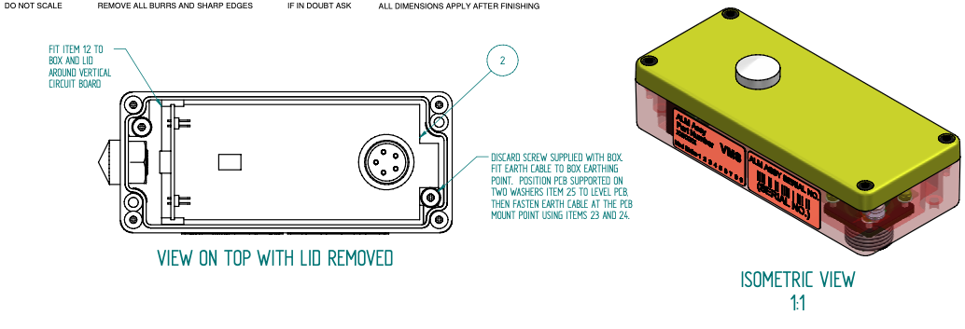
MS4 ALM
www.infratec-uk.com

Slide 17
End of Section
Questions
www.infratec-uk.com

Slide 18
VMS Version 3
AMI
www.infratec-uk.com

Slide 19
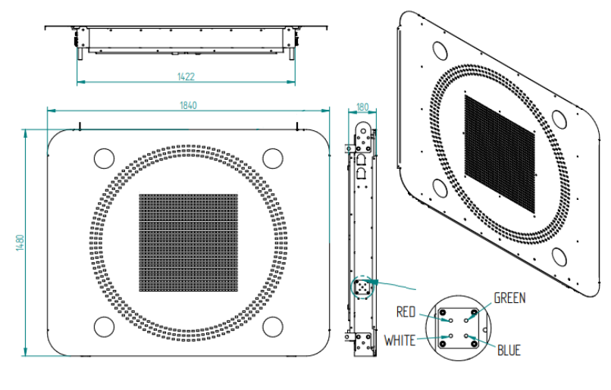
AMI General
Dimensions | 1840mm x 1480mm x 90mm
Weight | 90kg
Power consumtion | 300W Maximum
PSUs | 2x
Character Modules | 4 x MS4 V3, 8 x Red ring segments, 4 x Lanterns
Parameter | Value
Display Type | Matrix RGB LEDs, Red Ring, and Lantern
Input Voltage Range | 80 - 264VAC, 47 - 63Hz
Lantern Type | Physically separate compliant to BS EN 12368:2015 And BSEN 12966:2014
Optical Performance | BSEN 12966:2014 C2, L3, R3
Environmental Performance | BSEN 12966:2014 T1, P3, SP2
Reaction to horizontal load | WL8; PL0, DSL0; TDB1
www.infratec-uk.com

Slide 20
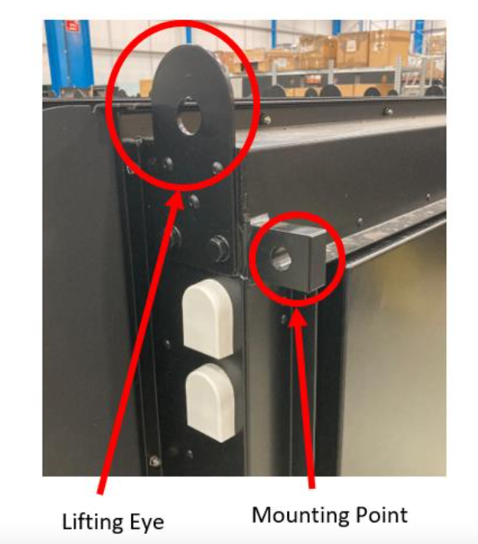
AMI Mounting and Lifting
www.infratec-uk.com

Slide 21
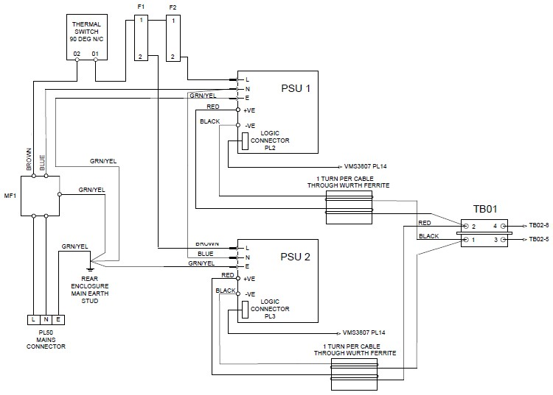
Header
Figure 38 - AMI Supplies
www.infratec-uk.com

Slide 22
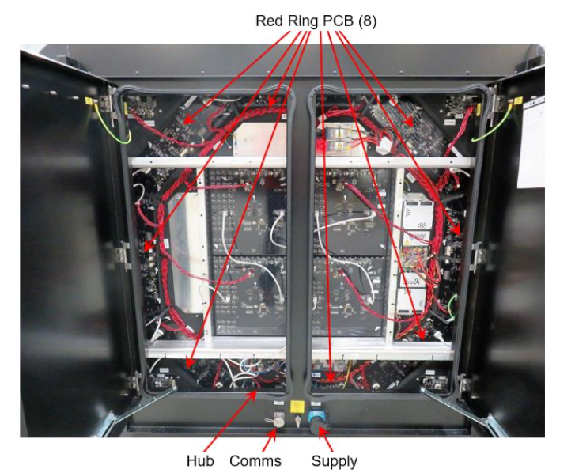
Header
www.infratec-uk.com

Slide 23
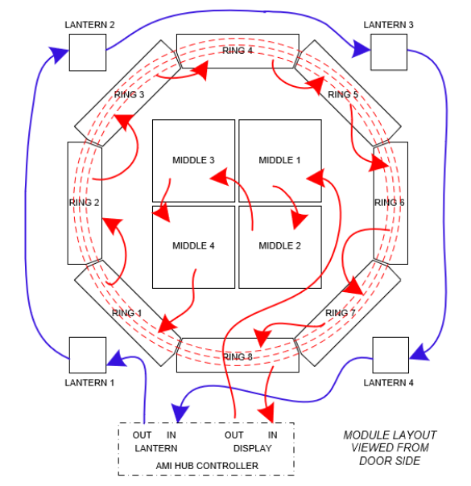
AMI Cat5 Cable Routing
FROM THE BACK
www.infratec-uk.com

Slide 24
Character Module User LEDS
LED | Purpose | Indication
USER0&1 | Lantern sync | Flashes at 400 msec with the Lantern Sync signal. This signal is synchronised by messages received from the Gantry Controller via the Hub
USER8 | Tx indicator (USARTS 1 to 3) | Transmit Indicator Flashes on replies to messages received from the Gantry Controller, on either the primary or secondary comms channel, via the Hub
USER9 | Rx indicator (USARTS 1 to 3) | Receive Indicator
 |  | Flashes on receipt of messages received from the Gantry Controller, on either the primary or secondary comms channel, via the MS4 Controller / Hub.
USER11 | Heartbeat | Flashes when the software is running.
USER13 | Timer Tick/ Address Configured | Flashes with the 1 msec timer tick signal (appears to be continuously illuminated due to speed)
www.infratec-uk.com

Slide 25
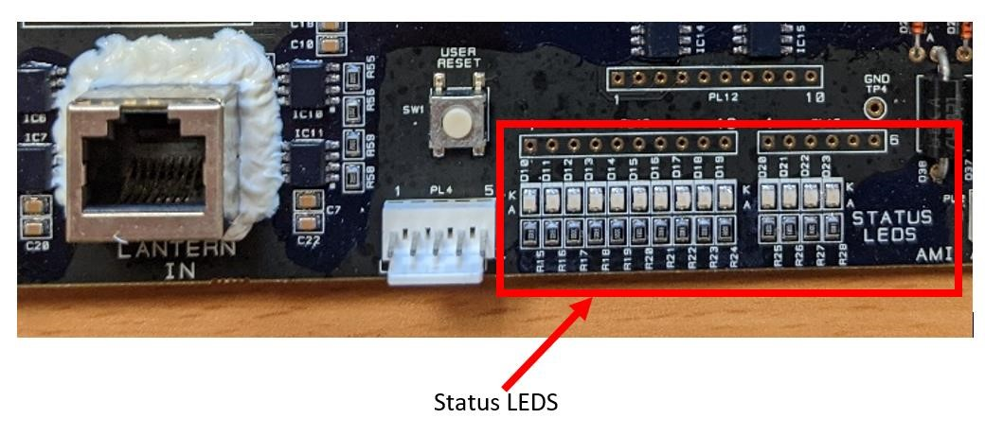
AMI Hub Status LEDs
www.infratec-uk.com

Slide 26
AMI Hub Status LEDs
LED | Purpose First 5 seconds of operation | Addressing mode Internal addressing of peripherals | Indication After system has addressed and in normal operation | Failure When the HUB is in transparent mode
User LED 0 | Address (MSB) | Off | Flashes at 1HZ | Last state
User LED 1 | Address Success | Flashes at 1HZ whilst addressing | On all the time | State is OFF. Character Module is not addressed Check HUB STATUS LEDS. Check Communications wiring. Power cycle/replace.
User LED 2 | USART RX status | Off | Pulses when a valid internal message is received from channel 2 secondary (Lanterns) ** | State is OFF. Transmission to GC has been affected. Check wiring back to the GC. Check GC for Faults.
User LED 3 | USART Tx Status | Off | Pulses when a message is transmitted on channel 2 secondary (Lanterns) ** | State is OFF. Transmission to Lanterns has been affected. Check wiring back to the Lanterns. Check power and comms cabling to Lanterns.
User LED 4 | USART RX status | Off | Pulses when a valid internal message is received from channel 2 primary (Lanterns) | State is OFF. Transmission to GC has been affected. Check wiring back to the GC. Check GC for Faults.
User LED 5 | USART Tx Status | Off | Pulses when a message is transmitted on | State is OFF. Transmission to Lanterns has been
User LED 6 | USART RX status | Off | Pulses when a valid internal message is received from channel 1 secondary (Tiles or Red Ring) ** | State is OFF. Transmission to GC has been affected. Check wiring back to the GC. Check GC for Faults.
User LED 7 | USART Tx Status | Off | Pulses when a message is transmitted on channel 1 secondary (Tiles or Red Ring) ** | State is OFF. Transmission to RR and Character Module has been affected. Check wiring back to the RR. Check power and comms cabling to RR and Character Modules
User LED 8 | USART RX status | Off | Pulses when a valid internal message is received from channel 1 primary (Tiles or Red Ring) | State is OFF. Transmission to GC has been affected. Check wiring back to the GC. Check GC for Faults.
www.infratec-uk.com

Slide 27
End of Section
Questions
www.infratec-uk.com

Slide 28
VMS Version 3
Roadside Controller
www.infratec-uk.com

Slide 29
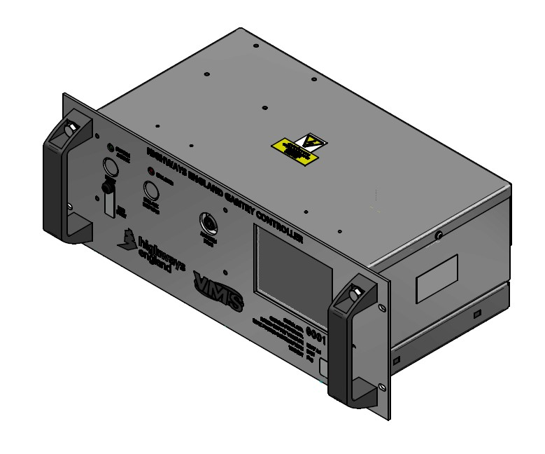
Roadside Controller
GANTRY CONTROLLER
www.infratec-uk.com

Slide 30
Roadside Controller
In this Section
NRTS Interface (SFP/cat5)
RSC Navigation
Software upload
Download logs
RMAS Interface
www.infratec-uk.com

Slide 31
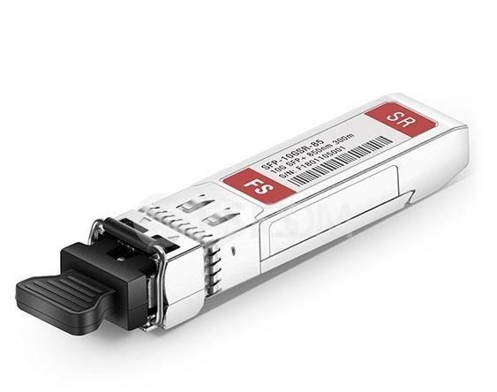
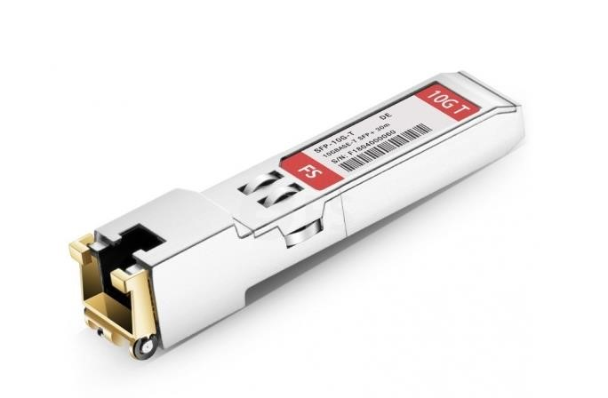
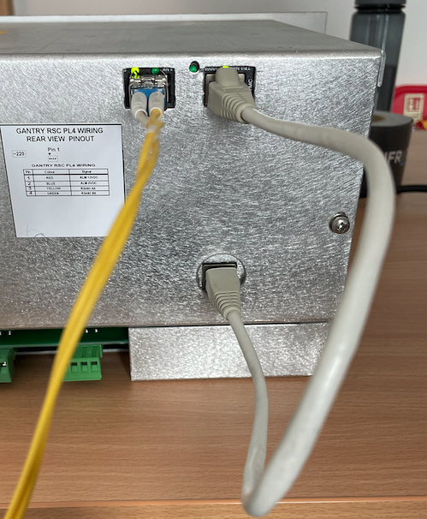
Interfaces
The external data interfaces between the GC and the NRTS infrastructure is achieved in two ways.
The first is through a Small Form-factor Pluggable interface or SFP interface on the rear of the GC. This interface allows either fibre or copper (RJ45 Ethernet) connections to be made.
The second is direct into the bottom RJ45 socket
www.infratec-uk.com

Slide 32
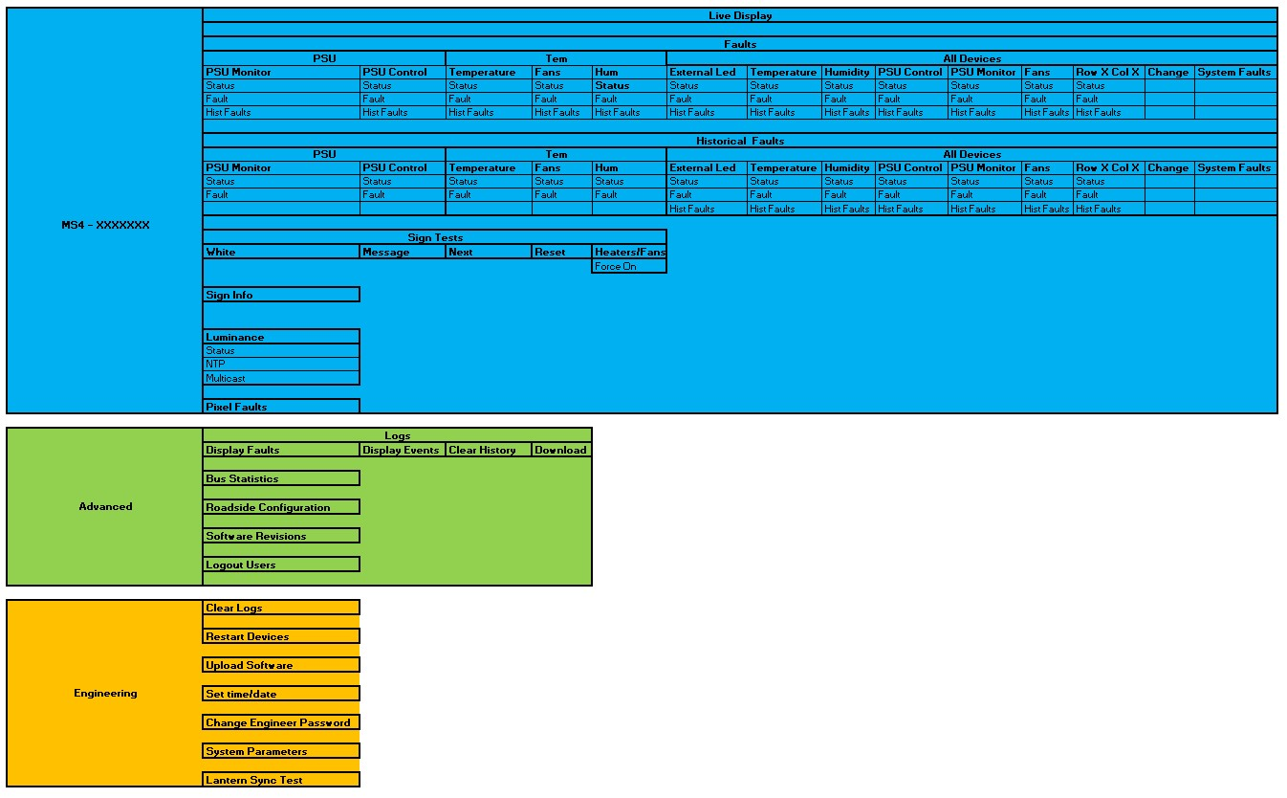
RSC Navigation
www.infratec-uk.com

Slide 33
Update Software
Roadside – Follow onscreen instructions
Remote – Via the RMAS interface
www.infratec-uk.com

Slide 34
AMI – Download Logs
Select this option and enter the Engineers password when asked. Then follow the onscreen instructions to copy the five data items listed below to an USB memory stick
Fault LOGs (current and old – time and date stamped)
Event LOGs (current and old – time and date stamped)
Contents of the address plug (location, addresses, etc.)
Snapshot of Current and Historical faults for each device.
List of software packages and their version numbers which are installed on the Roadside Controller.
These text files will be downloaded and written into a folder ‘rc’ and a subfolder ‘logs’ with a filename including the current time and date.
www.infratec-uk.com

Slide 35
End of Section
Questions
www.infratec-uk.com

